Slide 1
\LaTeX
For Scientific Documentation
By Ammar Taha Mohamedy
Building Tables Part 1

Slide 2
What is a Table ?
Data
Data
Data
Data

Slide 3
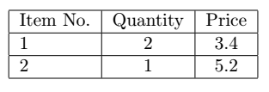
|
Vertical Lines.
l, r, and c
Left, Right, Center Justification.
\hline
Horizontal Lines.
\begin{tabular}{ }
\end{tabular}
|l|c|c|
\hline
Item No. & Quantity & Price \\
\hline
1 & 2 & 3.4 \\
\hline
2 & 1 & 5.2 \\
\hline

Slide 4
Thanks for Watching !!

